Slide 1

While you wait
Follow us on twitter - @pybamm_
Star us on GitHub - PyBaMM
Fill out the PyBaMM Survey - survey.pybamm.org
Try our online examples - colab.pybamm.org

Slide 2


Python Battery Mathematical Modelling

Slide 3
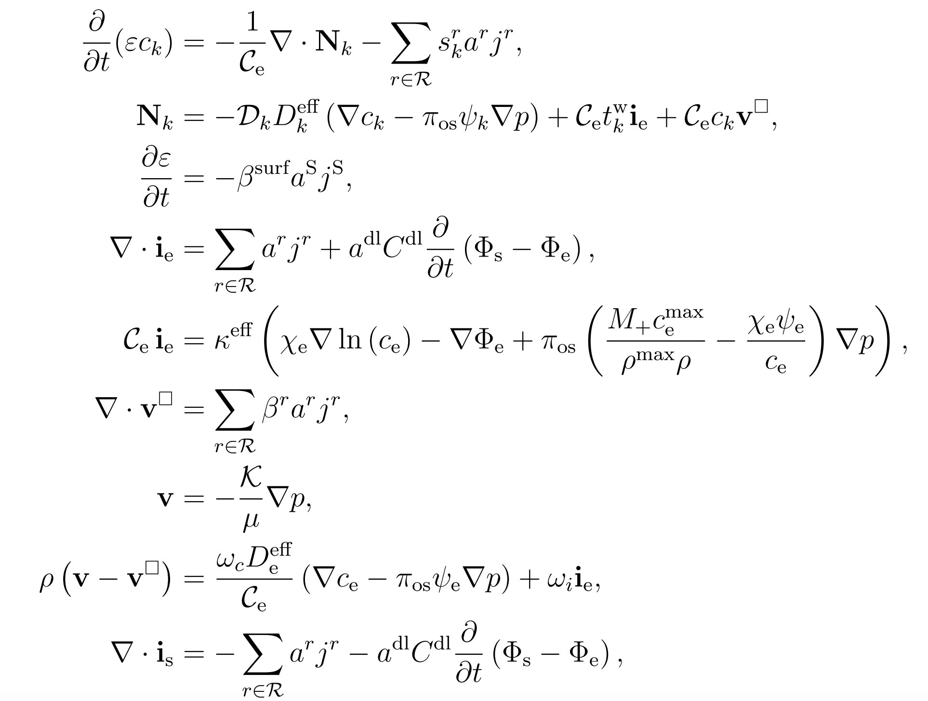
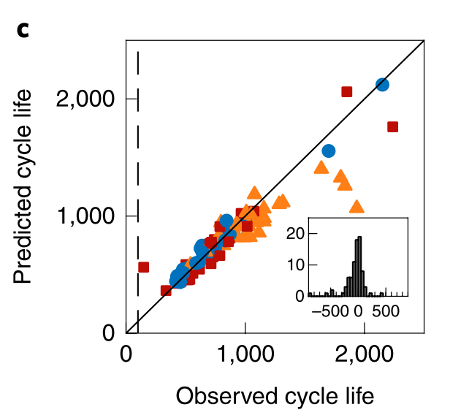
Why model batteries?
Batteries are complicated!
We have lots of data, why not just do machine learning?
Not *that* much battery data (+ curse of dimensionality)
Electrochemical models can:
Provide physical insight
Be generalized
Regularize data-driven methods
Need to be:
Fast (enough)
Easy to use, share, understand
Reliable
Ultimately, will need hybrid approach
Data-driven prediction of battery cycle life before capacity degradation. K.A. Severson et al., Nature Energy, 2019

Slide 4
Why PyBaMM?
PyBaMM's mission is to accelerate battery modelling research
by providing an open-source framework for multi-institutional,
interdisciplinary collaboration.
Fostering a Sustainable Community in Batteries, J.A. Baker, M. Beuse, S.C. DeCaluwe, L.W. Jing, E. Khoo, S. Sripad, U. Ulissi, A. Verma, A.A. Wang, Y.T. Yeh, N. Yiu, D.A. Howey, and V. Viswanathan, ACS Energy Letters, 2020

Slide 5
PyBaMM Goals
Provide fast, reliable battery simulations
Grow battery modelling user-base
Facilitate development of new battery models
Improve reproducibility of research

Slide 6
Who is PyBaMM?
Core Developers
Faraday Institution
Oxford
Imperial
Maths
Computer science
Engineering
Michigan
PyBaMM
Mechanical Engineering
Warwick
UCL
WMG
Elec. Innovation Lab

Slide 7
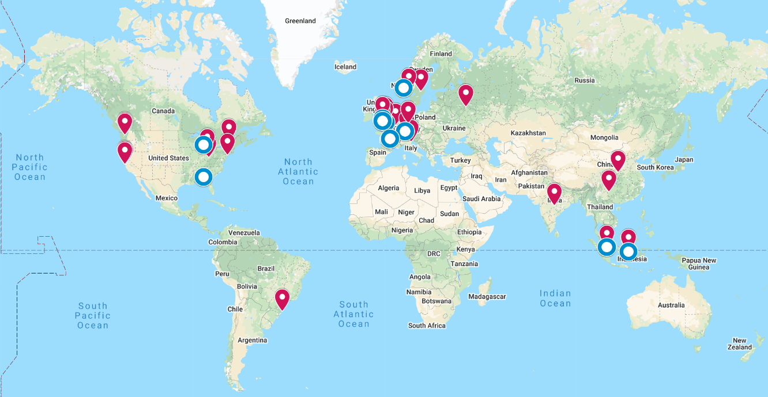
Who is PyBaMM?
Active and growing community
Star
Fork
GitHub Interactions Data collected from publicly available location information github.com/pybamm-team/PyBaMM

Slide 8
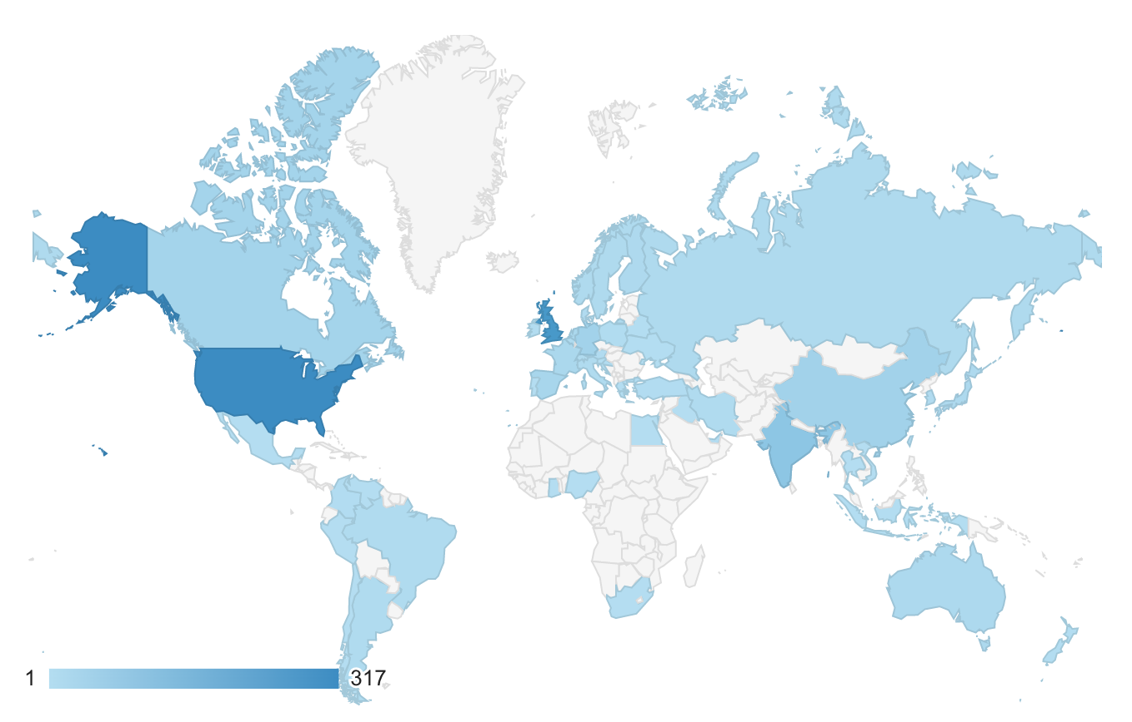
Who is PyBaMM?
Active and growing community
Number of website hits

Slide 9
PYBAMM BASICS

Slide 10
What is PyBaMM?
PyBaMM is a framework for building and solving battery models
FAST
FLEXIBLE
RELIABLE
Models
Lithium-ion models (full and reduced-order)
Lead-acid models
Fully coupled thermal models
Degradation mechanisms (SEI)
Experimental suite
Any voltage, current or power control, for example:
GITT, PITT, CCCV, drive cycle
Easy interface to define custom protocols
Library of Chemistries / Parameters
LCO, LiNiCo02, NCA, NMC
Graphite
LiPF6 ​
Easy to add your own parameter sets
Functionality
Range of numerical methods for solving models
Choice of cell geometries: 1D, 2+1D single layer pouch cells
Interface with external software

Slide 11
Flexible Submodel Structure
r
x
Battery models are constructed from submodels
Use or adapt pre-built models
Create custom models
r
x
PyBaMM includes popular battery model such as the Doyle-Fuller-Newman model (P2D) and the Single Particle Model
Stefan
Maxwell
Fickian Diffusion
Lumped Thermal
Custom Model
Users can build custom models from submodels

Slide 12
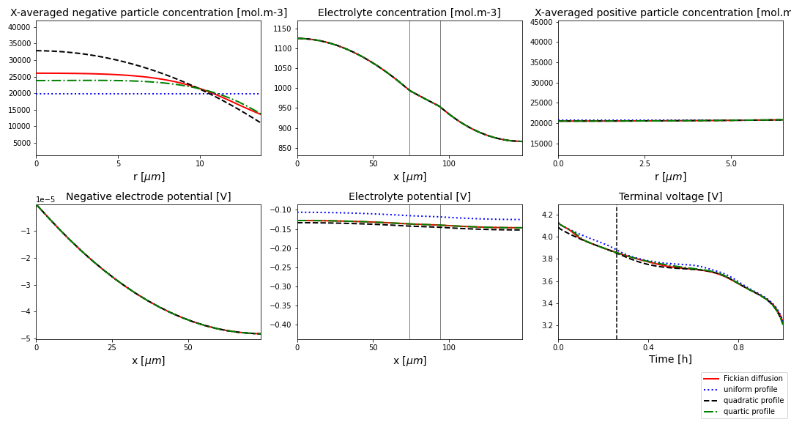
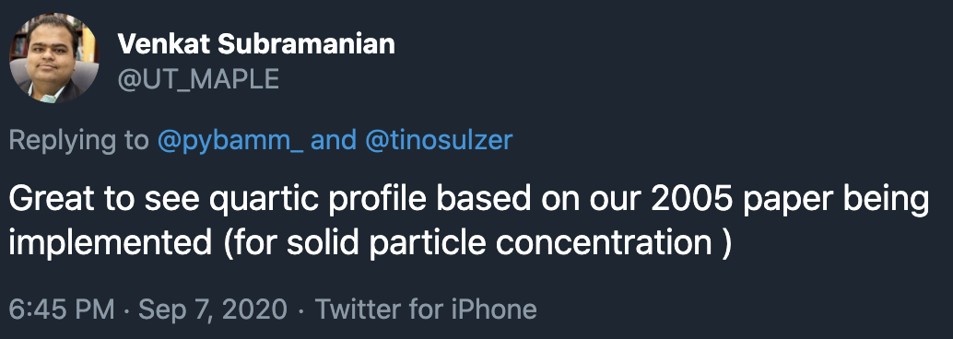
Flexible Submodel Structure
Structure allows for
“plug and play” physics
New physics can be quickly implemented in an independent fashion
Different physical mechanisms are readily included in both full and reduced-order models
Using PyBaMM it is easy to compare how different physics affects the model solution. Here we investigate the influence of different models for the particles (Fickian diffusion, and three reduced-order polynomial approximations [Subramanian et al., 2005]).

Slide 13
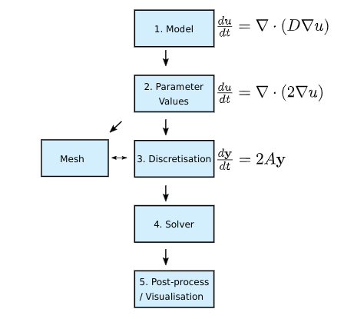
PyBaMM Pipeline
Choice of spatial discretisation
Finite Volume Method
Spectral Volume Method
Finite Element Method
Multiple ODE and DAE solvers (e.g. scipy, sundials CVODE and IDA)
Obtain Jacobians via automatic differentiation
[Work in progress] Sensitivity analysis via automatic differentiation
Martin Robinson, Oxford RSE
By employing a pipeline process PyBaMM separates the statement of model equations from the inputted parameters, choice of spatial discretization and choice of time stepping algorithm.

Slide 14
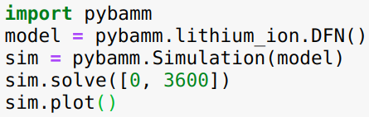
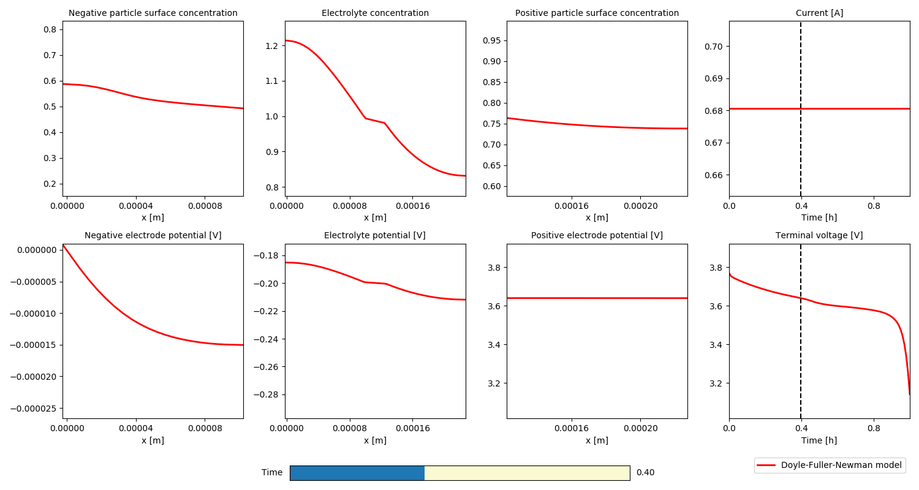
Simple Interface: CC Discharge
Easy interface for running simulations
Both model and simulation can be customised

Slide 15
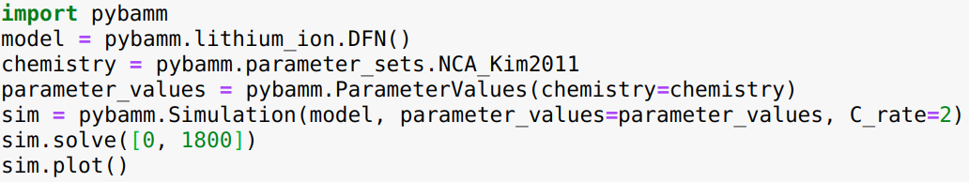
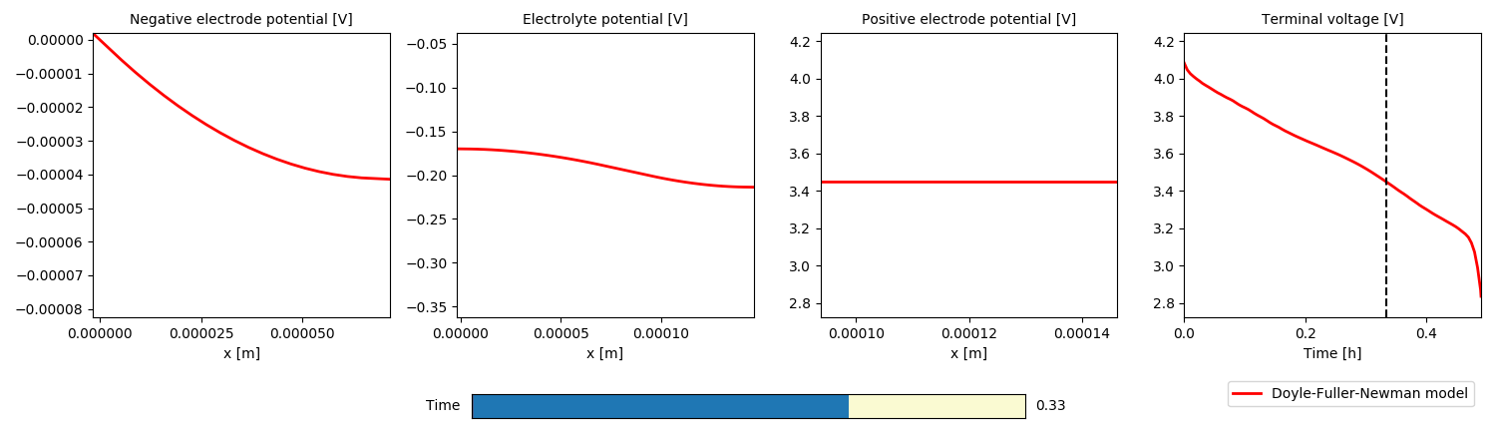
Simple Interface: Change parameters
Easy to change parameters and model options

Slide 16
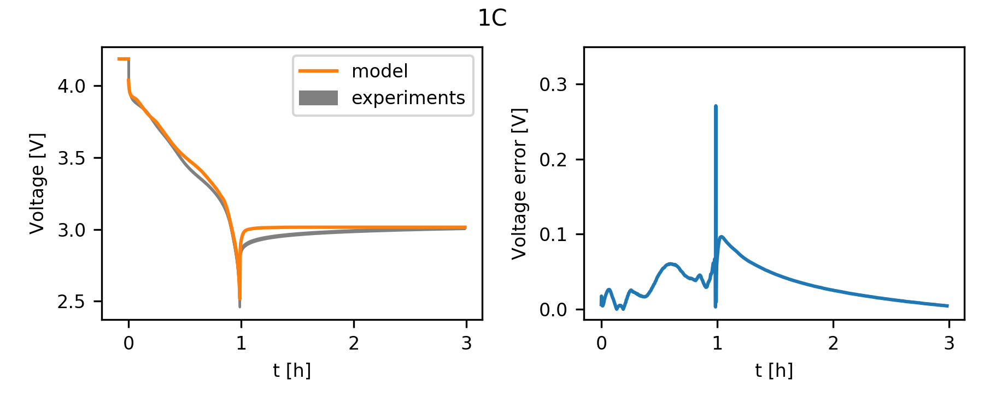
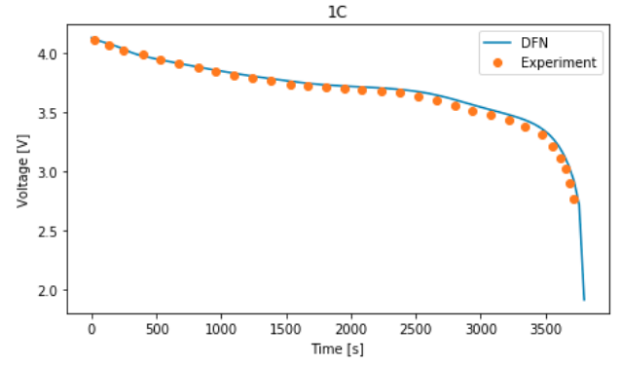
Parameter Library
Library of parameter values including popular chemistries such as LiNiCo02, NMC, Graphite, LiPF6
Choose by component (anode, cathode, etc.) or pick a complete parametrization from ​a given reference
Easy to “tweak” existing parameter sets or add your own from scratch
Development of Experimental Techniques for Parameterization of Multiscale Lithium-ion Battery Models, Chang-Hui Chen, Ferran Brosa Planella, Kieran O’Regan, Dominika Gastol, W. Dhammika Widanage and Emma Kendrick, Journal of The Electrochemical Society, 2020
Parameterization of a physico-chemical model of a lithium-ion battery II. Model validation, Madeleine Ecker, et al, Journal of The Electrochemical Society, 2015

Slide 17
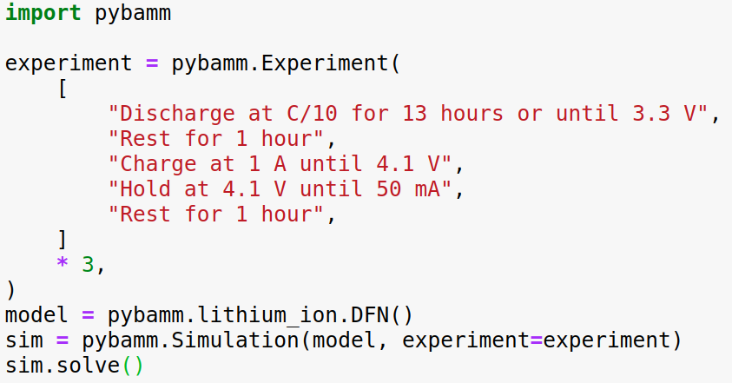
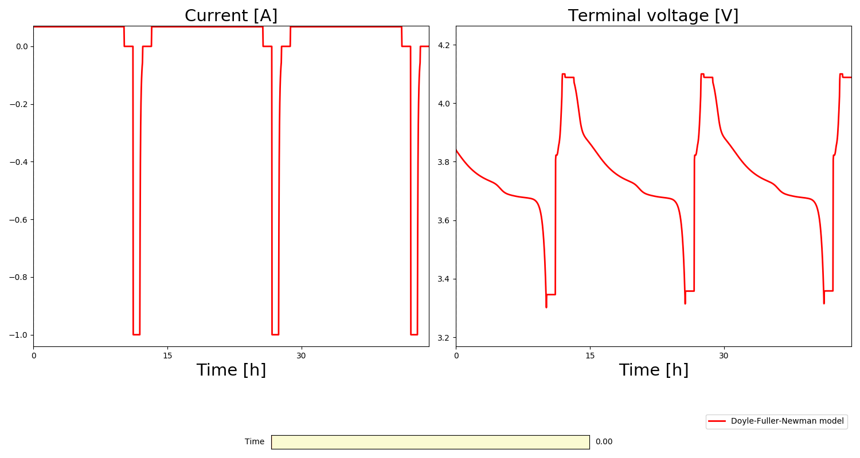
Simple Interface: Experimental protocol
PyBaMM allows users to specify experimental protocols using keyword strings
Can easily define custom protocols
Specify current, power or voltage

Slide 18
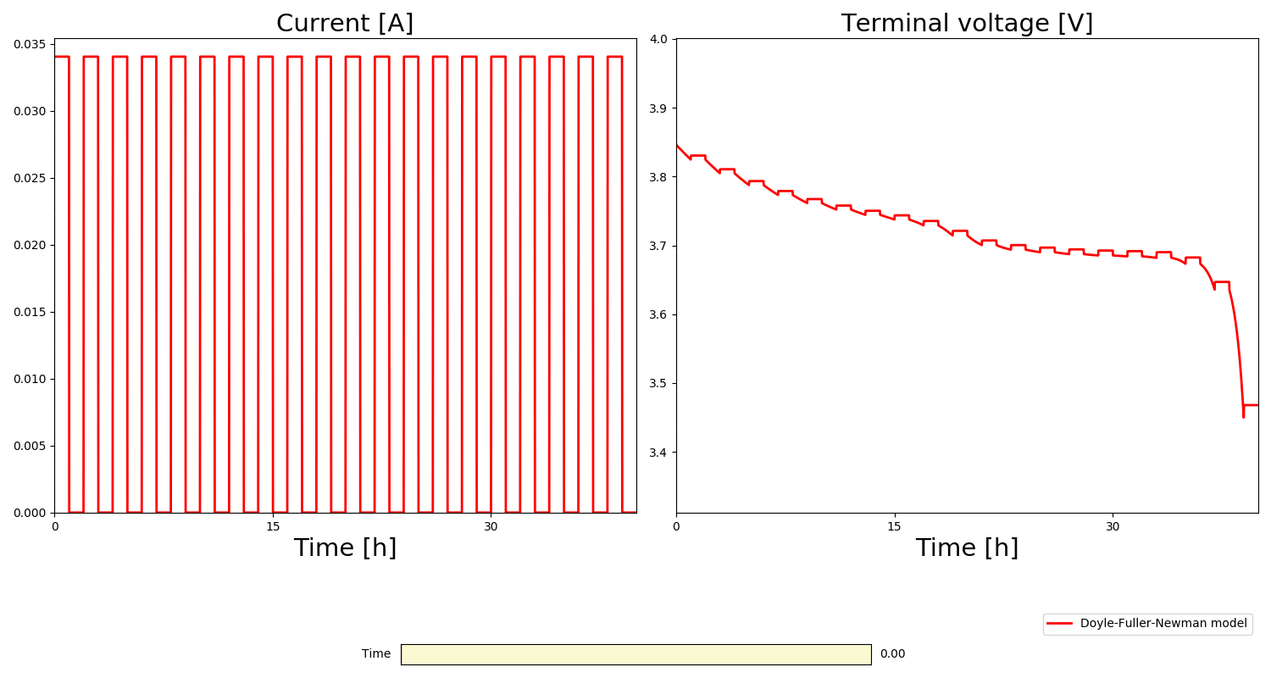
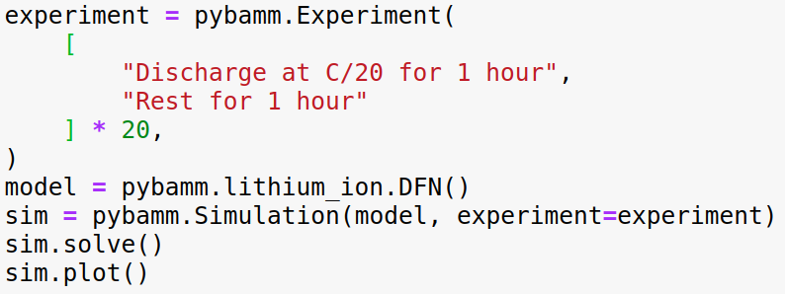
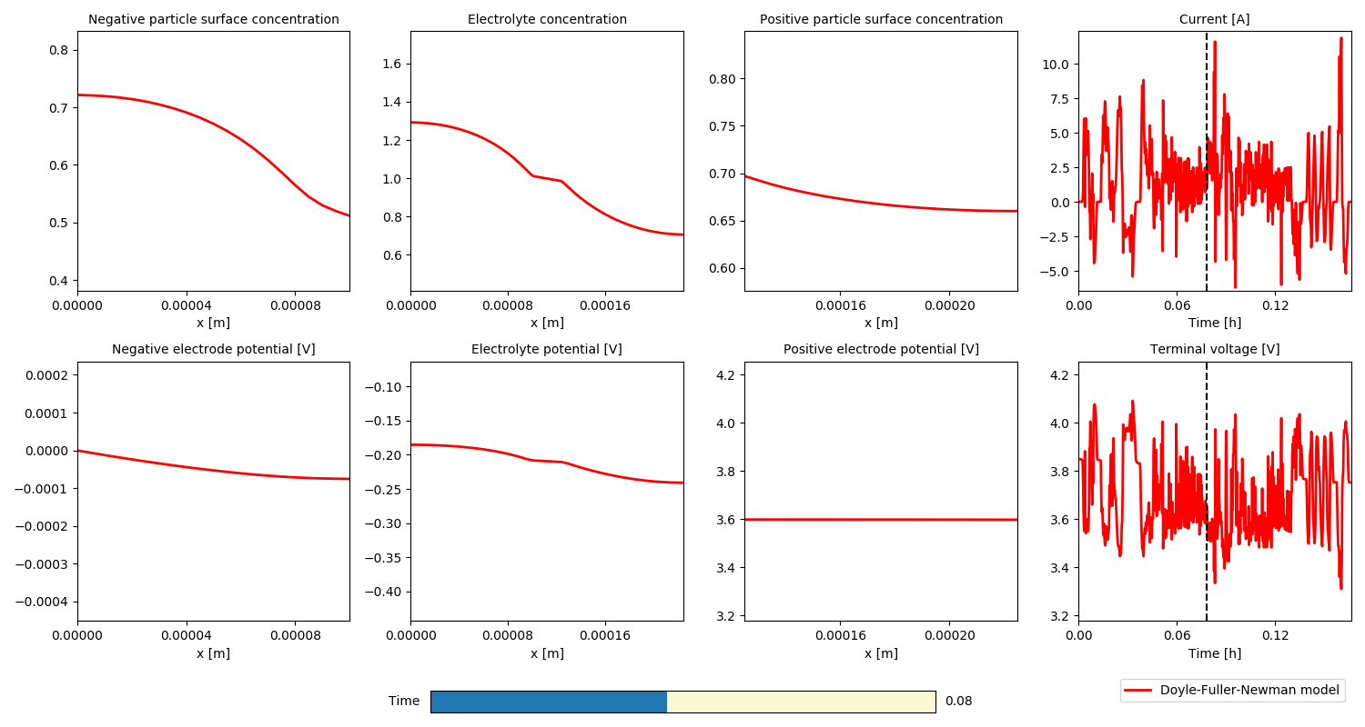
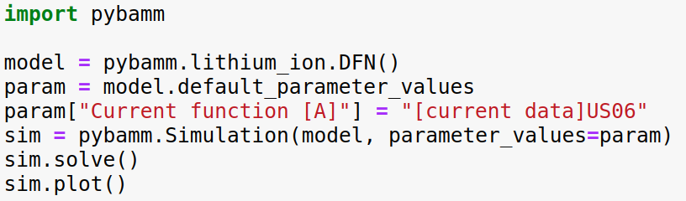
Simple Interface: Experimental protocols & drive cycles

Slide 19
Fast Solve Times
A comparison of typical solve times for different models and disrectisations for a 1C constant current discharge.
Grid points per domain | Single Particle Model |  | Doyle-Fuller-Newman Model
 | States | Time (milliseconds) | States | Time (milliseconds)
10 | 21 | 3 | 281 | 72
20 | 41 | 3 | 961 | 149
40 | 81 | 4 | 3251 | 384
80 | 161 | 5 | 13441 | 1293
160 | 321 | 9 | 52481 | 7689
All simulation performed on a laptop computer (i5, 2.1 GHz, 16 Gb of RAM) using the CasADi solver with both absolute and relative tolerances of 10⁻⁶ . The parameters are from the reference:
An asymptotic derivation of a single particle model with electrolyte, S.G. Marquis, V.Sulzer, R. Timms, C.P. Please and S.J. Chapman, Journal of The Electrochemical Society 2019

Slide 20
Fast Solve Times
A comparison of typical solve times for different models and disrectisations for the US06 drive cycle
Grid points per domain | Single Particle Model |  | Doyle-Fuller-Newman Model
 | States | Time (seconds) | States | Time (seconds)
10 | 21 | 0.03 | 281 | 4.01
20 | 41 | 0.03 | 961 | 7.53
40 | 81 | 0.04 | 3251 | 20.30
80 | 161 | 0.07 | 13441 | 66.19
160 | 321 | 0.10 | 52481 | 247.15
All simulation performed on a laptop computer (i5, 2.1 GHz, 16 Gb of RAM) using the CasADi solver with both absolute and relative tolerances of 10⁻⁶ . The parameters are from the reference:
An asymptotic derivation of a single particle model with electrolyte, S.G. Marquis, V.Sulzer, R. Timms, C.P. Please and S.J. Chapman, Journal of The Electrochemical Society 2019

Slide 21
CASE STUDIES

Slide 22
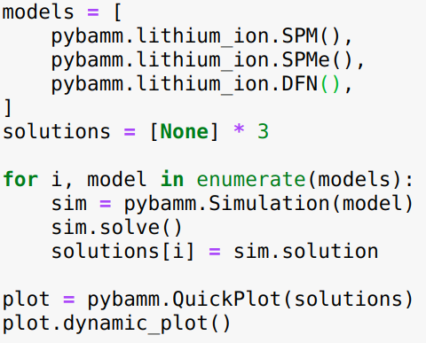
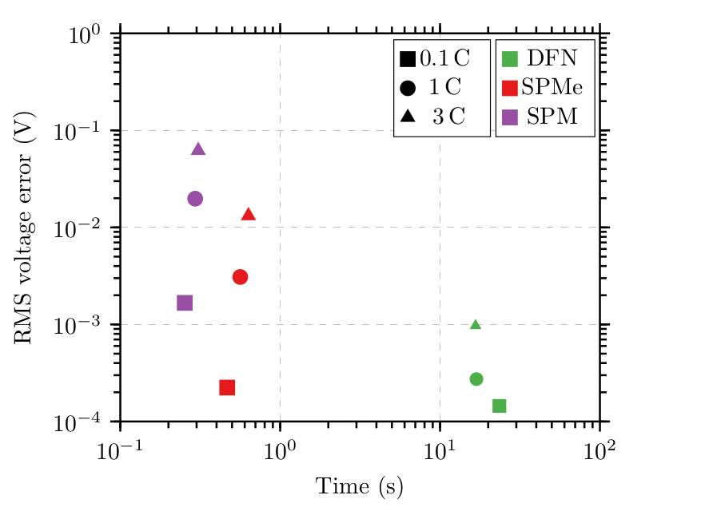
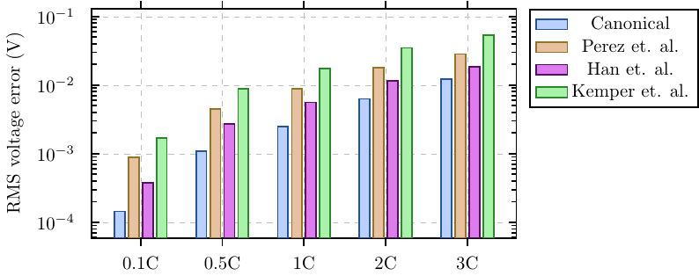
Case Study: Single Particle Model with electrolyte (SPMe)
Systematic derivation of SPMe using asymptotic methods
Electrolyte diffusion time << discharge time
Large electrode and electrolyte conductivity
Outperforms other (ad hoc) models in literature of similar complexity
Achieves order of magnitude reduction in computation cost at small loss of accuracy
Extends the validity of SPM to higher C-rates.
An asymptotic derivation of a single particle model with electrolyte, S.G. Marquis, V.Sulzer, R. Timms, C.P. Please and S.J. Chapman, Journal of The Electrochemical Society 2019

Slide 23
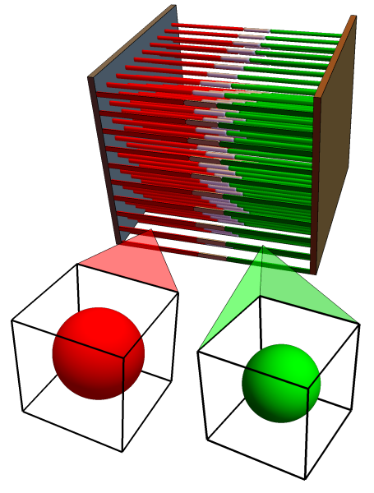
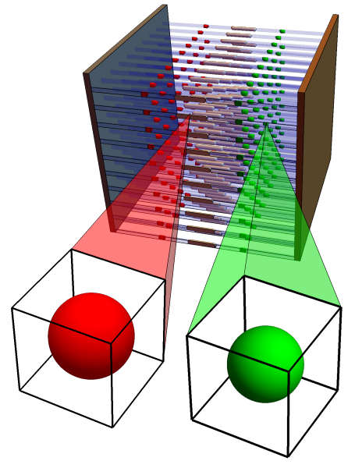
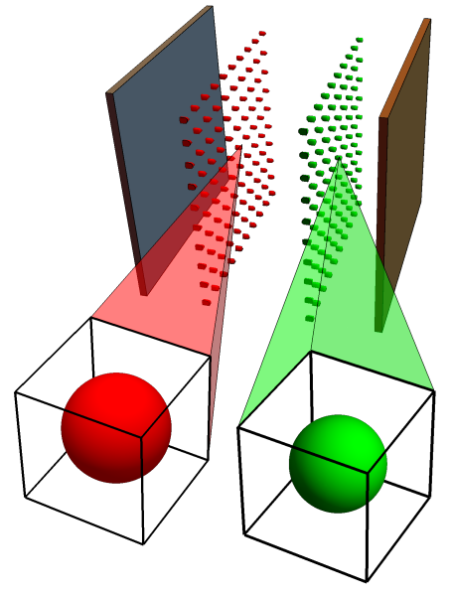
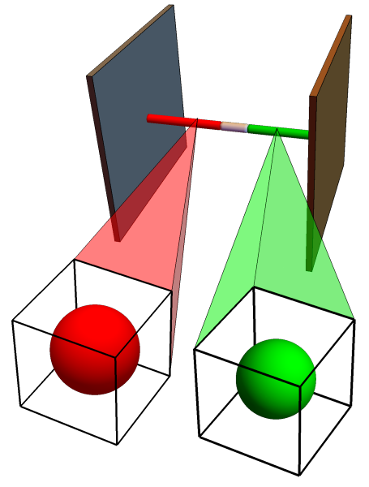
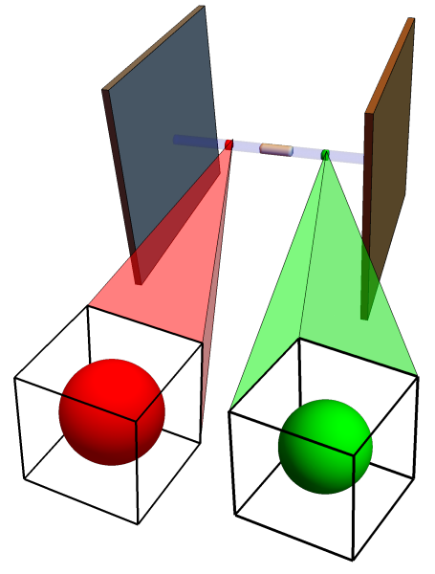
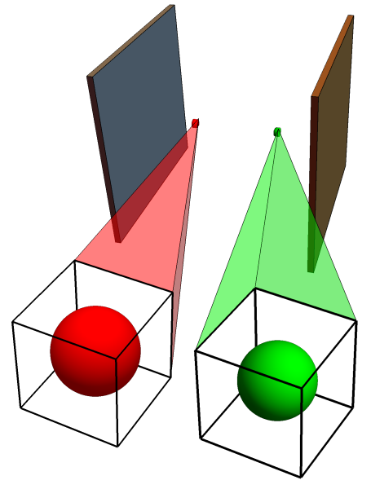
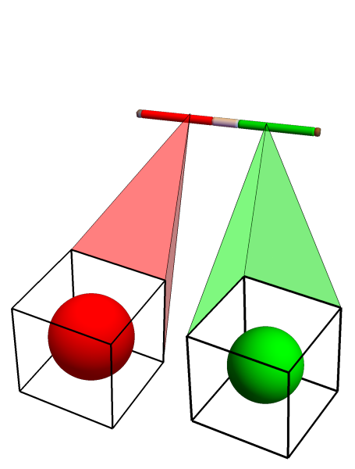
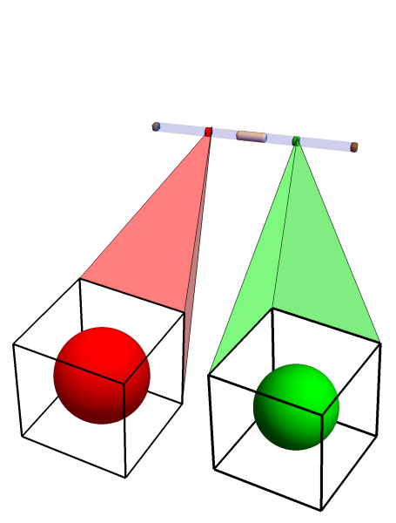
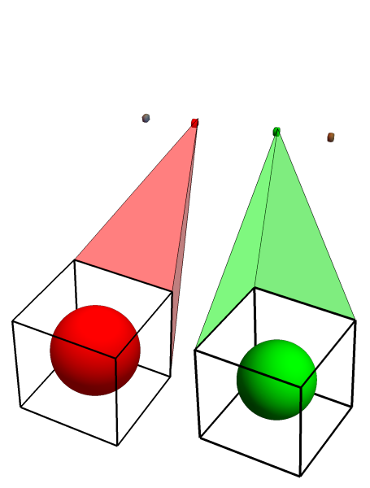
Case Study: Reduced order pouch cell modelling
Larger batteries exhibit non-uniform behaviour which may adversely affect battery performance and lifetime
Exploit the geometry to systematically derive 2+1D model
Combine with other limits to derive a hierarchy of reduced-order models
Influence of cell geometry can be investigated efficiently
Numerical validation against “full” model in COMSOL
Asymptotic Reduction of a Lithium-ion Pouch Cell Model, R. Timms, S.G. Marquis, V.Sulzer, C.P. Please and S.J. Chapman, Submitted to SIAM Journal on Applied Mathematics
A Suite of Reduced-Order Models of a Single-Layer Lithium-ion Pouch Cell, S.G. Marquis, R. Timms, V.Sulzer, C.P. Please and
S.J. Chapman, Submitted to Journal of the Electrochemical Society

Slide 24
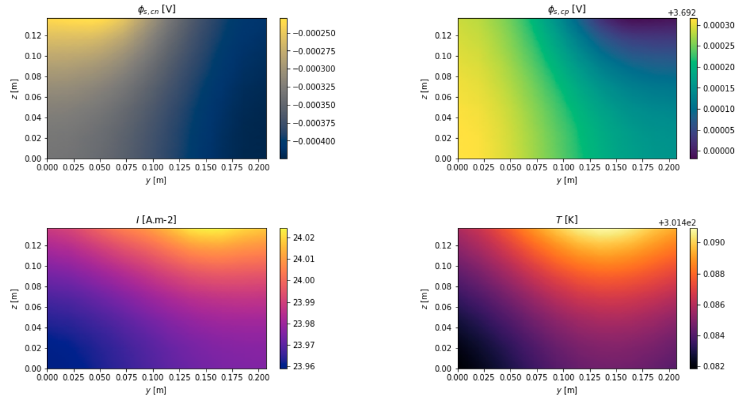
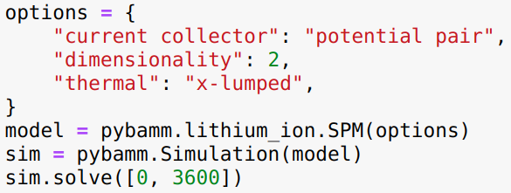
Case Study: Reduced order pouch cell modelling
Example result: 10x10 grid of Single Particle Models with fully coupled thermal effects. Approximate solve time: 9s
Asymptotic Reduction of a Lithium-ion Pouch Cell Model, R. Timms, S.G. Marquis, V.Sulzer, C.P. Please and S.J. Chapman, Submitted to SIAM Journal on Applied Mathematics
A Suite of Reduced-Order Models of a Single-Layer Lithium-ion Pouch Cell, S.G. Marquis, R. Timms, V.Sulzer, C.P. Please and
S.J. Chapman, Submitted to Journal of the Electrochemical Society

Slide 25
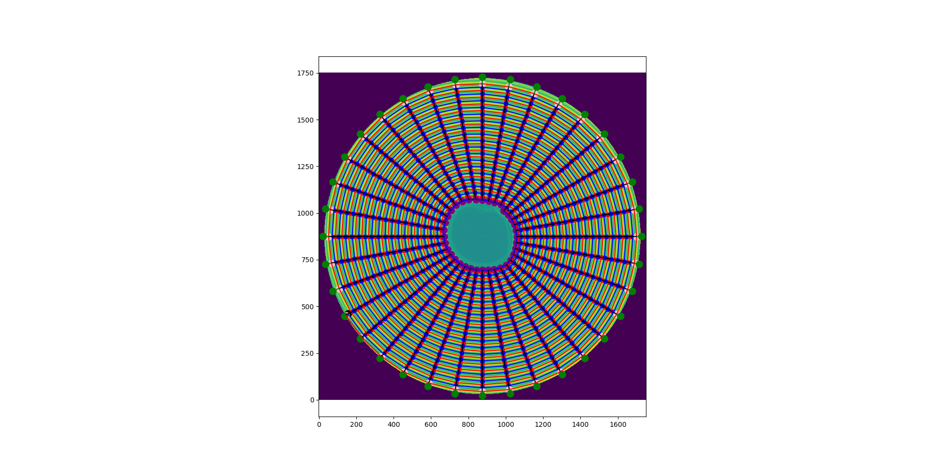
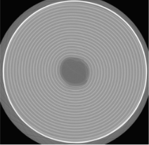
Case Study: A coupled multiscale model of electrochemistry
and thermal transport for Li-ion cells
Internal temperature differences lead to non-uniformities in current flow, state of charge, particle stress and levels of degradation
Li-ion battery heat generation and transport problem coupling:
particle scale electrochemical modelling (PyBaMM)
cell level electrical and thermal modelling (OpenPNM)
Example: a 2D heat-transfer problem for spirally rolled cylindrical batteries using tomography data
Probing heterogeneity in Li-ion batteries with coupled multiscale models of electrochemistry and thermal transport using tomographic domains, T.G. Tranter, R. Timms, T.M.M. Heenan, S.G. Marquis, V. Sulzer, A. Jnawali, M.D.R. Kok, C.P. Please, S.J. Chapman, P.R. Shearing, D.J. L. Brett, Journal of The Electrochemical Society, 2020

Slide 26
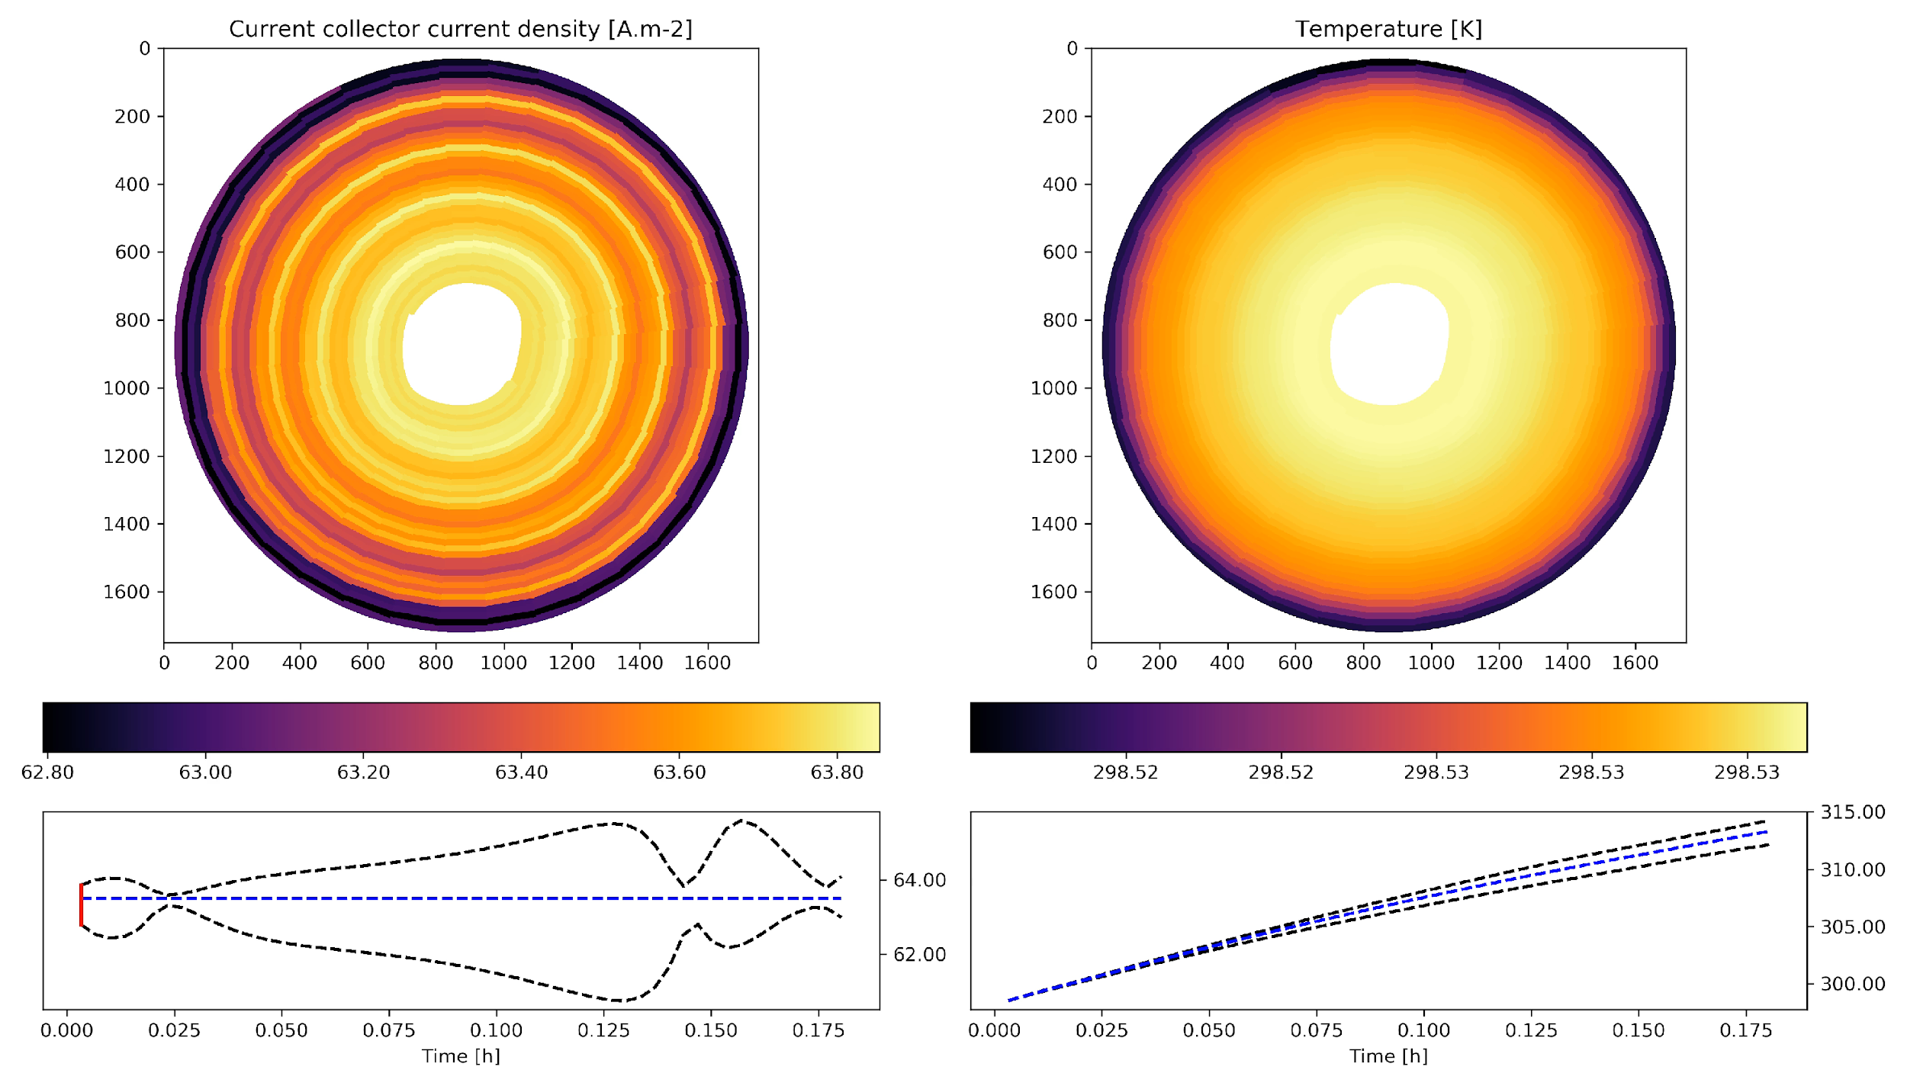
Case Study: A coupled multiscale model of electrochemistry
and thermal transport for Li-ion cells
HTC = 5 [W.m-2]
σ = 3e7 [S.m-1]
#tabs = 5
Current = 5 [A]
Probing heterogeneity in Li-ion batteries with coupled multiscale models of electrochemistry and thermal transport using tomographic domains, T.G. Tranter, R. Timms, T.M.M. Heenan, S.G. Marquis, V. Sulzer, A. Jnawali, M.D.R. Kok, C.P. Please, S.J. Chapman, P.R. Shearing, D.J. L. Brett, Journal of The Electrochemical Society, 2020

Slide 27
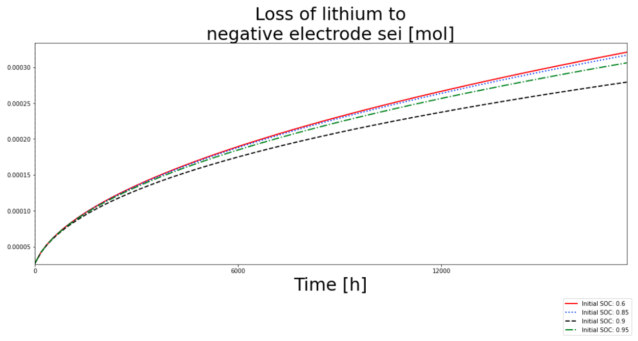
Case Study: SEI models
SEI models for:
constant SEI thickness
reaction limited
solvent-diffusion limited
electron-migration limited
interstitial-diffusion limited
EC-reaction limited
Example: loss of lithium to negative electrode SEI using the interstitial-diffusion limited model with different initial SOCs

Slide 28
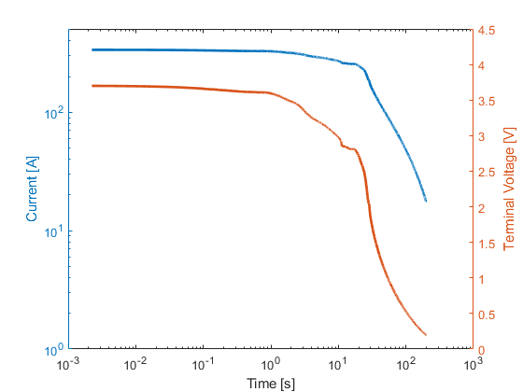
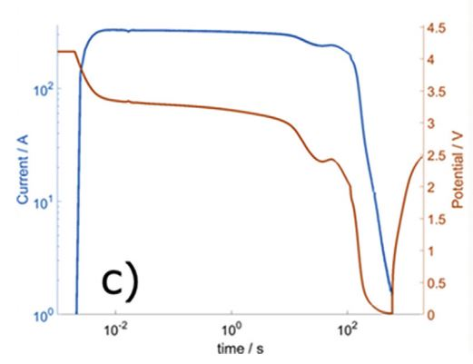
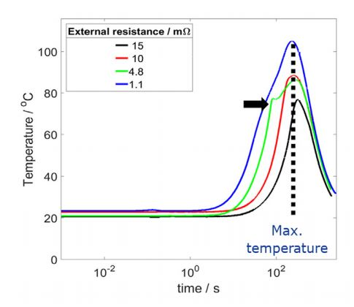
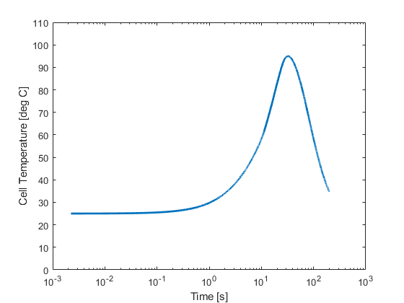
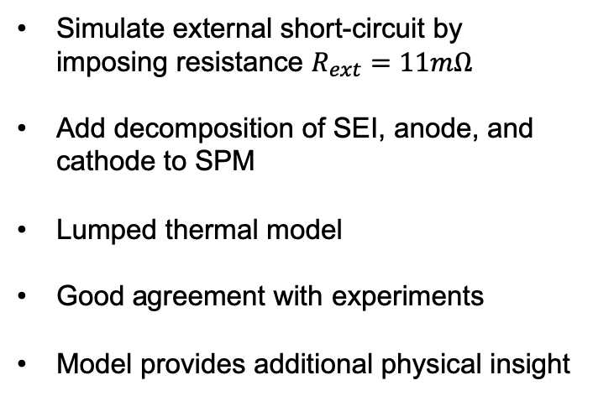
Case Study: Thermal runaway under external short-circuit
Experiment (Kriston et al)
Simulation
Simulate external short-circuit by imposing resistance $R_{ext}=11mΩ$
Add decomposition of SEI, anode, and cathode to SPM
Lumped thermal model
Good agreement with experiments
Model provides additional physical insight
Experiment (Kriston et al)
Simulation
External short circuit performance of Graphite-LiNi1/3Co1/3Mn1/3O2 and Graphite-LiNi0. 8Co0. 15Al0. 05O2 cells at different external resistances, A. Kriston et al, Journal of Power Sources, 2017
For more information, contact Vivian Tran, Department of Mechanical Engineering, University of Michigan

Slide 29
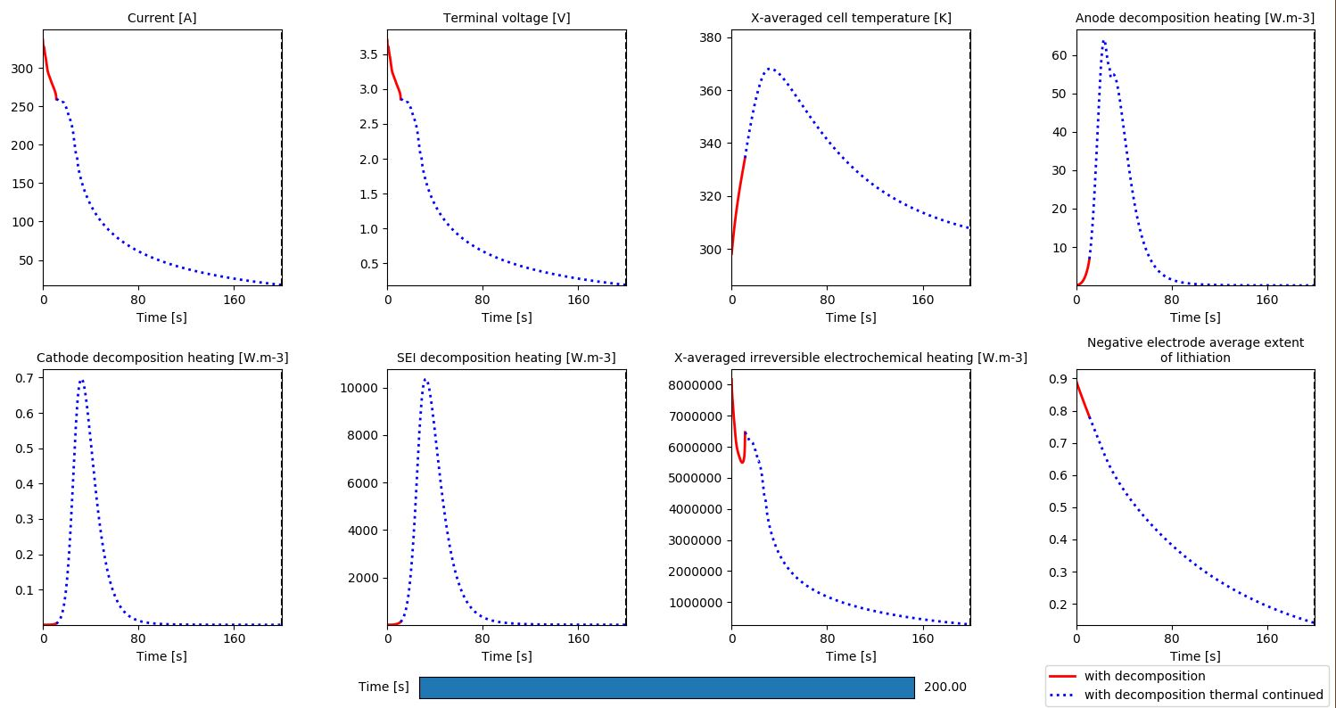
Case Study: Thermal runaway under external short-circuit
For more information, contact Vivian Tran, Department of Mechanical Engineering, University of Michigan

Slide 30
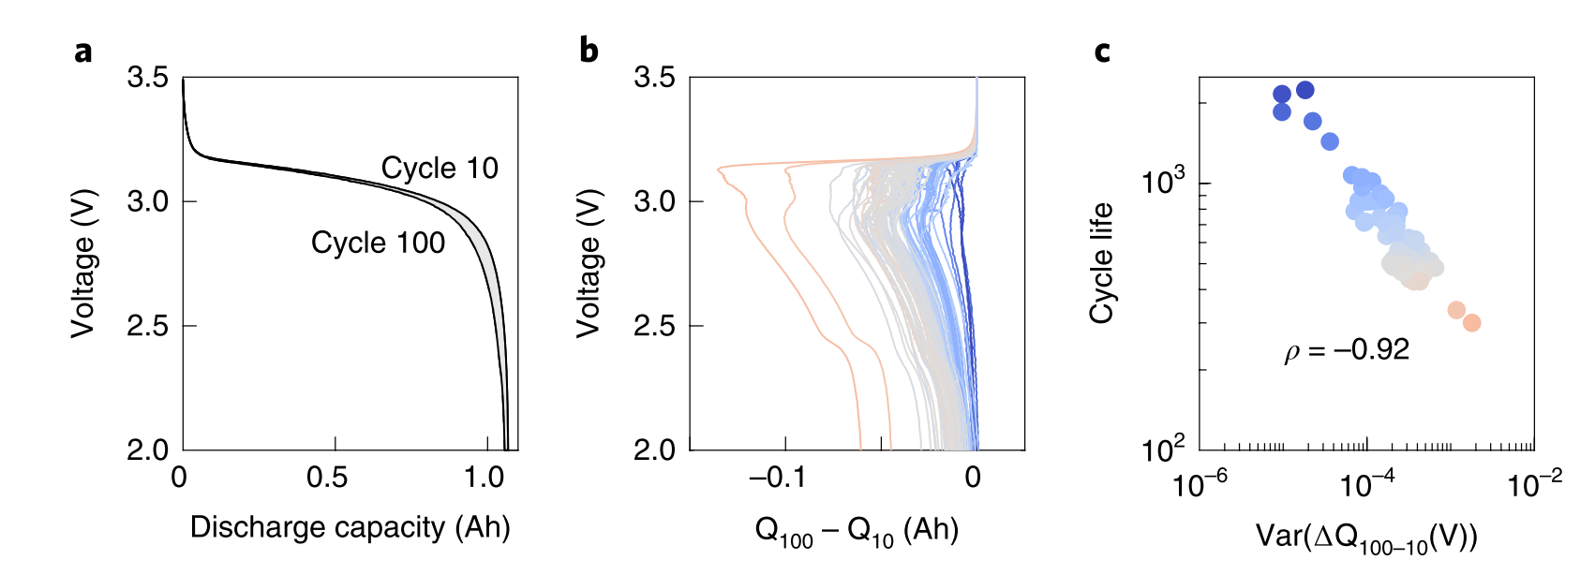
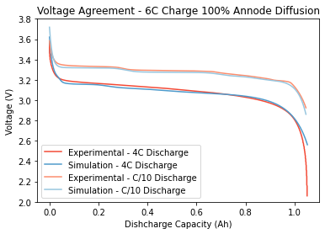
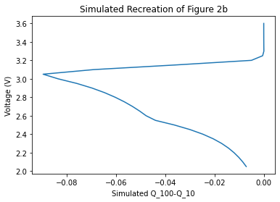
Case Study: Understanding LFP degradation
Recent work by Severson et al. shows that features from discharge voltage curves can be used to predict cycle life
Use PyBaMM to fit DFN model to battery data, giving excellent agreement
Changing the anode diffusion coefficient produces features as seen in the data
﻿Data-driven prediction of battery cycle life before capacity degradation, K.A. Severson et al., Nature Energy, 2019
Work led by Daniel Albamonte, University of Michigan. For more information contact Dr V Sulzer, Department of Mechanical Engineering, University of Michigan

Slide 31
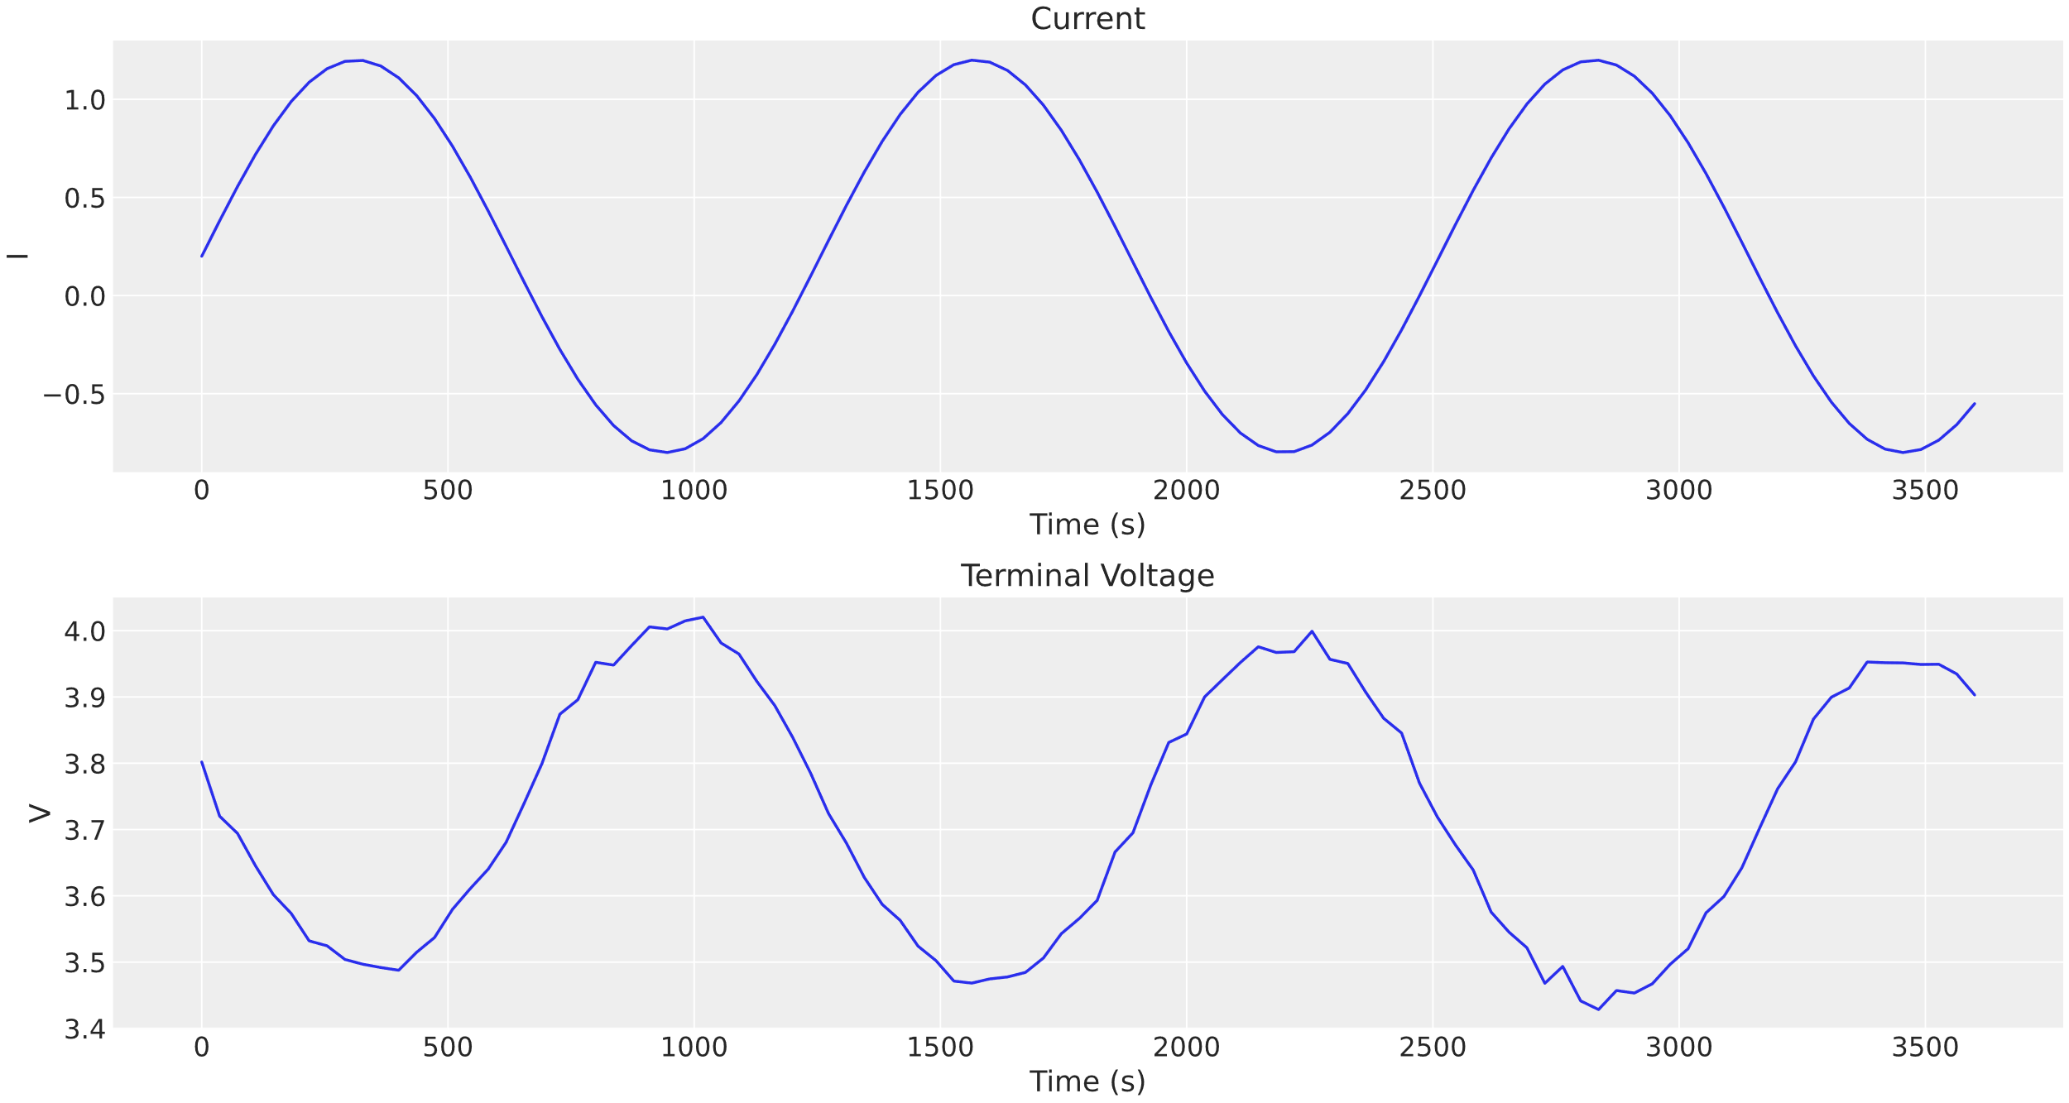
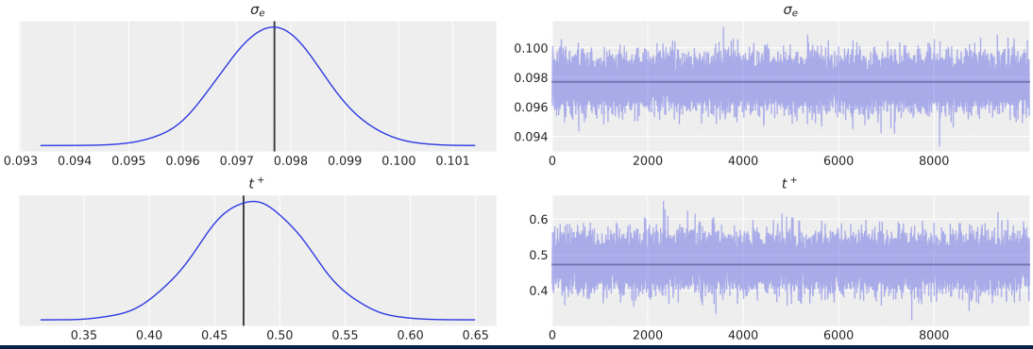
Case Study: Variational Bayes
Wrapping pymc3, a Bayesian library, around PyBaMM’s SPMe
Generate synthetic data with noise
Use Variational Bayes to recover probability distributions for electrolyte conductivity and transference number
For more information contact Antti Aitio, Battery Intelligence Lab, University of Oxford

Slide 32
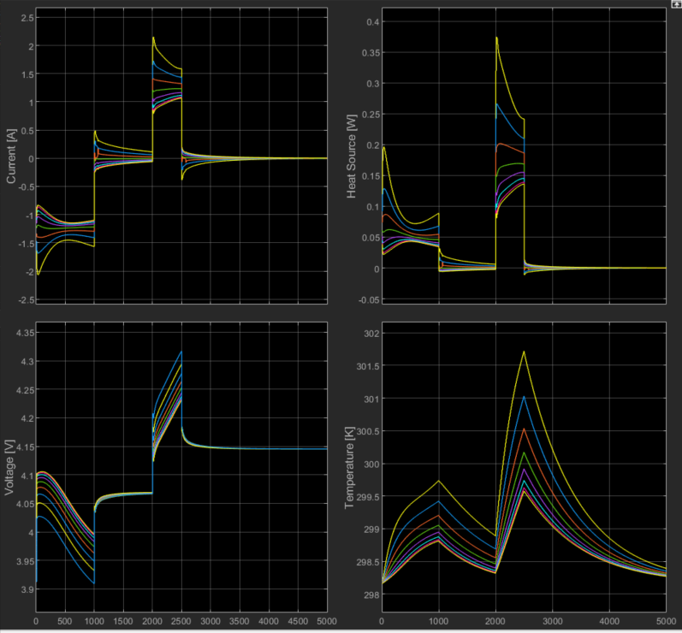
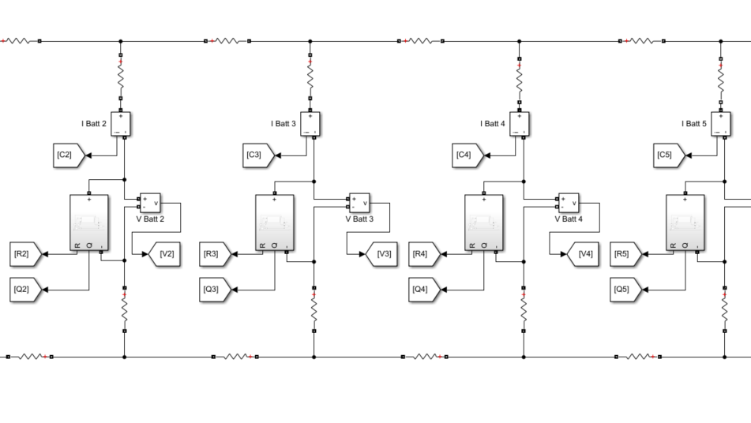


Highlighted upcoming feature: pack modelling using PyBaMM and Simulink
Black box PyBaMM model put in Matlab system
Linked in circuit with busbar and connection resistances
Pack level electrical and thermal problem solved in Simulink
Casadi solver used to efficiently call battery functions
Input currents and temperatures
Output heat and voltage sources and internal resistance calculated with physics based models
For more information contact Dr T Tranter, UCL Electrochemical Innovation Lab

Slide 33
Highlighted upcoming feature: Integration with Julia
PyBaMM
Julia (SciML)
Create symbolic model
Create symbolic model (ModelingToolkit.jl)
Discretize (DiffEqOperators.jl)
Solve Physics-Informed Neural Network
(NeuralPDE.jl)
Solve ODEs/DAEs
(DifferentialEquations.jl)
For more information contact Dr V Sulzer, Department of Mechanical Engineering, University of Michigan

Slide 34
Upcoming features
Sensitivity analysis & parameter estimation
Simulink interface
Particle size distribution
Other chemistries (LiS)
Different particle shapes
Lithium plating
Fuel cells
Mechanics coupled to temperature and lithiation
Solid-state battery models
Improvements to framework
Other geometries (jelly rolls, multiple layer cells, etc.)
Integration with open battery database, parameter database
… your ideas?
Work commenced
Planned work
Future work

Slide 35

Further information – pybamm.org

Slide 36
Contributors

Slide 37
USING PYBAMM

Slide 38



How to use PyBaMM?
Ways to engage
Try online
Use PyBaMM in your browser without any installation.
Install locally
Install PyBaMM on your computer.
Develop
Clone git repository to
contribute code.

Slide 39

How to use PyBaMM?
Training resources
Lots of new resources online at
pybamm.org/getting-started
Training delivered via Faraday masterclass and tech series training
Recordings and resources available online
Over 50 attendees
Getting Started notebooks
Run in your browser via Google Colab -- no need to install PyBaMM!

Slide 40



Google Colab
Online tutorials run interactively in your browser using Google Colab, removing the need to install PyBaMM locally

Slide 41






Contributing
If you would like to work on something in private please get in touch!
Create an issue where new proposals can be discussed before any coding is done
Create a branch of PyBaMM on your own fork where all changes will be made
Implement your work
Add relevant references to CITATIONS.txt
Register these in the parts of the code that use your paper
Test your code!
Create a pull request to merge into the main code when you are ready for your code to be publicly available

Slide 42

How to ensure your contribution is credited
Example: Ferran Brosa Planella, WMG
Added LGM50 parameter set on his own fork
Added reference to relevant paper
Merged into main code
PyBaMM generates BibTeX entries for the papers cited in the script
When the parameters set “Chen2020” is used, PyBaMM returns the citation

